Slide 1
Cybersecurity Threats in Internet of Medical Things (IoMT): Challenges and Responses in the Healthcare Sector

Slide 2

Introduction
The adoption of IoMT in healthcare is rapidly expanding, offering benefits such as real-time monitoring and personalised care (Alhaj et al., 2022).
This presentation analyses key cybersecurity vulnerabilities and the effectiveness of existing countermeasures.
Emphasis is placed on the CIA triad—Confidentiality, Integrity, and Availability—as critical to secure IoMT environments (Brown et al., 2023).

Slide 3
Research Questions
What are the main cybersecurity threats affecting IoMT systems?
How effective are current protection mechanisms in mitigating these threats?
Can artificial intelligence enhance the cybersecurity posture of IoMT infrastructure?

Slide 4
Methodology and Source Selection
Sources were selected from IEEE Xplore, ScienceDirect, PubMed, and SpringerLink.
Keywords: “IoMT cybersecurity,” “medical device security,” “AI in healthcare IoT.”
Timeframe: Studies and publications from 2018 to 2024.
Focus on peer-reviewed articles, technical white papers, and international cybersecurity policies.

Slide 5
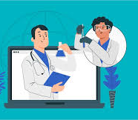
IoMT in Healthcare – An Overview
Core components include sensors, communication networks, cloud platforms, and decision-making algorithms (Fahim-Ul-Islam et al., 2025).
IoMT enables continuous monitoring, telehealth, and data-driven treatment strategies (Mushtaq et al., 2021).
The global IoMT market is projected to reach USD 285 billion by 2029.

Slide 6
Types of IoMT Devices and Applications
Device/Application | Description
Insulin Pumps | Automatically deliver insulin to manage diabetes in real time.
Pacemakers | Monitor and regulate heart rhythm for cardiac patients.
Wearable ECG Monitors | Continuously track heart activity and send alerts for abnormalities.
Imaging Scanners | Digitally capture and transmit radiological data (e.g., CT, MRI).
Remote Patient Monitoring | Allows doctors to track patient vitals remotely and intervene early.
Cloud-Based Systems | Enable centralised diagnostics, data sharing, and resource management.

Slide 7
Key Cybersecurity Threats
Threat Type | Impact
Ransomware | Encrypts data and demands payment for access; e.g., WannaCry.
Phishing | Tricks users into revealing sensitive information via fake emails or links.
Malware | Malicious software that can disrupt or spy on device operations.
DDoS Attacks | Overloads networks or servers, causing service outages.
Supply Chain Attacks | Exploits vulnerabilities in third-party components or vendors.
Insider Threats | Employees or contractors misusing access privileges to compromise systems (Bughio et al., 2024).

Slide 8
Human Factors and Legacy Systems
Many breaches are caused by lack of staff awareness about phishing and social engineering.
Healthcare systems often rely on outdated software and unpatched firmware, making them vulnerable to known exploits that could easily be avoided with regular maintenance.
Vendors frequently fail to coordinate timely security updates and patches, leading to prolonged exposure to threats and weak points in the system.

Slide 9
Compliance and Regulatory Challenges
Regulatory Standards
Enforcement Gaps
Cross-Border Data Transfers
Laws like HIPAA in the U.S. and GDPR in the EU are designed to protect the confidentiality and integrity of health data in IoMT systems.
Implementation and enforcement of these regulations vary widely between regions, leading to compliance challenges and uneven data protection.
International data movement faces legal complications, especially after the Schrems II ruling, which disrupted established data-sharing frameworks.

Slide 10
Security Solutions and AI Innovations
Security Measure | Function
Encryption | Protects data by converting it into unreadable formats for unauthorised users.
Network Segmentation | Isolates critical systems to limit the spread of cyberattacks (Mushtaq et al., 2021).
Multi-Factor Authentication | Requires multiple verification steps for access, increasing login security.
Blockchain | Provides immutable, secure records for medical data storage.
AI-Based Intrusion Detection | Uses machine learning to identify and respond to threats in real time.
Manickam (2022) | Manickam (2022) highlights the role of AI in enhancing the security and functionality of IoMT devices, particularly in point-of-care healthcare systems.

Slide 11
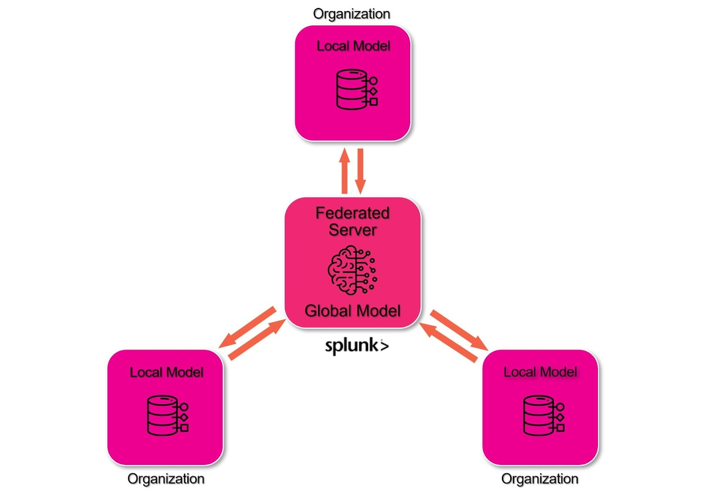
AI and Federated Learning
AI models detect threats in real time with minimal human intervention (Sadhu et al., 2022).
Federated learning allows secure, decentralised model training without exposing raw data.
Challenges include lack of model transparency and high computational demands (Shree et al., 2024).

Slide 12
Implementation Challenges
Technical Issues
Cost Limitations
Communication Gaps
A major challenge is the lack of interoperability between IoMT devices and healthcare platforms, which hinders smooth integration and secure data exchange.
High implementation and maintenance costs limit adoption, especially in public hospitals and underfunded healthcare systems.
Poor coordination between IT teams, clinicians, and administrators leads to delayed responses and weak overall cybersecurity strategies.

Slide 13
Critical Evaluation of Current Research
Many AI and blockchain tools are still in early prototype or testing stages.
Studies show mixed results on how scalable and effective these tools are in practice.
There's no global standard for securing IoMT, leading to inconsistent approaches.
Most research lacks validation in real clinical environments.

Slide 14
Research Gaps and Future Directions
There's a pressing need for global interoperability standards in IoMT.
Many AI solutions haven’t been tested in real-world healthcare settings.
Socioeconomic challenges in low-income regions are often overlooked.
Future studies should explore long-term security impacts and ethics.

Slide 15
Strategic Recommendations
Encourage secure-by-design practices for all medical IoT devices.
Support international collaboration on IoMT cybersecurity policies.
Provide regular cybersecurity training for healthcare professionals.
Build public-private partnerships to fund and guide innovation.

Slide 16
Conclusion
IoMT significantly enhances healthcare delivery but introduces complex cybersecurity challenges.
Technologies like AI and blockchain offer potential solutions but face technical and ethical obstacles.
A collaborative, multi-stakeholder approach is essential to ensure safe, secure IoMT deployment.

Slide 17
References
Algethami, S. A., & Alshamrani, S. S. (2024). A deep learning-based framework for strengthening cybersecurity in Internet of Health Things (IoHT) environments. Applied Sciences, 14(11), 4729. Available at: https://doi.org/10.3390/app14114729 (Accessed: 03 July 2025).
Alhaj, T. A., Abdulla, S. M., Iderss, M. A. E., Ali, A. A. A., Elhaj, F. A., Remli, M. A., & Gabralla, L. A. (2022). A survey: To govern, protect, and detect security principles on Internet of Medical Things (IoMT). IEEE Access, 10, 124777–124791. Available at: https://ieeexplore.ieee.org/document/9964214 (Accessed: 03 July 2025).
Bhukya, C. R., Thakur, P., Mudhivarthi, B. R., & Singh, G. (2023). Cybersecurity in Internet of Medical Vehicles: State-of-the-art analysis, research challenges and future perspectives. Sensors, 23(19), 8107. Available at: https://doi.org/10.3390/s23198107 (Accessed: 03 July 2025).
Bhushan, B., Kumar, A., Agarwal, A. K., Kumar, A., Bhattacharya, P., & Kumar, A. (2023). Towards a secure and sustainable Internet of Medical Things (IoMT): Requirements, design challenges, security techniques, and future trends. Sustainability, 15(7), 6177. Available at: https://doi.org/10.3390/su15076177 (Accessed: 03 July 2025).
Brown, S., Ruhwanya, Z., & Pekane, A. (2023). Factors influencing Internet of Medical Things (IoMT) cybersecurity protective behaviours among healthcare workers. In International Symposium on Human Aspects of Information Security and Assurance (pp. 432–444). Springer. Available at:https://doi.org/10.1007/978-3-031-38530-8_34 (Accessed: 04 July 2025).
Bughio, K. S., Cook, D. M., & Shah, S. A. A. (2024). Developing a novel ontology for cybersecurity in Internet of Medical Things-enabled remote patient monitoring. Sensors, 24(9), 2804. Available at: https://doi.org/10.3390/s24092804 (Accessed: 04 July 2025).
El-Saleh, A. A., Sheikh, A. M., Albreem, M. A., & Honnurvali, M. S. (2025). The Internet of Medical Things (IoMT): Opportunities and challenges. Wireless Networks, 31(1), 327–344. Available at: https://doi.org/10.1007/s11276-024-03764-8 (Accessed: 04 July 2025).

Slide 18
References
Fahim-Ul-Islam, M., Chakrabarty, A., Alam, M. G. R., & Maidin, S. S. (2025). A resource-efficient federated learning framework for intrusion detection in IoMT networks. IEEE Transactions on Consumer Electronics. Advance online publication. Available at:https://doi.org/10.1109/TCE.2025.3544885 (Accessed: 04 July 2025).
Guergov, S. (2022). Investigating E-Supply chain issues in Internet of Medical Things (IoMT): Evidence from the healthcare. International Journal of Computations, Information and Manufacturing (IJCIM), 2(2). Available at: https://doi.org/10.54489/ijcim.v2i2.110 (Accessed: 04 July 2025).
Manoharan, A., & Thathan, M. (2024). Enhanced IoMT security framework using group teaching optimized auto-encoder for intrusion detection. Scientific Reports, 14, Article 80581. Available at: https://doi.org/10.1038/s41598-024-80581-1 (Accessed: 04 July 2025).
Mushtaq, M., Shah, M. A., & Ghafoor, A. (2021). The Internet of Medical Things (IoMT): Security threats and issues affecting digital economy. In Competitive Advantage in the Digital Economy (CADE 2021) (Vol. 2021, pp. 137–142). IET. Available at: https://doi.org/10.3390/fi17030107 (Accessed: 05 July 2025).
Papaioannou, M., Karageorgou, M., Mantas, G., Sucasas, V., Essop, I., Rodriguez, J., & Lymberopoulos, D. (2022). A survey on security threats and countermeasures in Internet of Medical Things (IoMT). Transactions on Emerging Telecommunications Technologies, 33(6), e4049. Available at: https://doi.org/10.1002/ett.4049 (Accessed: 05 July 2025).
Sadhu, P. K., Yanambaka, V. P., Abdelgawad, A., & Yelamarthi, K. (2022). Prospect of Internet of Medical Things: A review on security requirements and solutions. Sensors, 22(15), 5517. Available at: https://doi.org/10.3390/s22155517 (Accessed: 05 July 2025).
Shafik, W. (2025). Artificial Intelligence-assisted Internet of Medical Things (AIoMTs) in sustainable healthcare ecosystem. In Sustainable Healthcare Systems (pp. 75–101). Available at: https://doi.org/10.1002/9781394287024.ch3 (Accessed: 05 July 2025).

Slide 19
References
Ree, S., Zhou, C., & Barati, M. (2024). Data protection in Internet of Medical Things using blockchain and secret sharing method. Journal of Supercomputing, 80, 5108–5135. Available at: https://doi.org/10.1007/s11227-023-05657-7 (Accessed: 05 July 2025).
Svandova, K., & Smutny, Z. (2024). Internet of Medical Things security frameworks for risk assessment and management: A scoping review. Journal of Multidisciplinary Healthcare, 2281–2301. Available at: https://doi.org/10.2147/JMDH.S459987 (Accessed: 05 July 2025).
Tarikere, S., Donner, I., & Woods, D. (2021). Diagnosing a healthcare cybersecurity crisis: The impact of IoMT advancements and 5G. Business Horizons, 64(6), 799–807. Available at: https://doi.org/10.1016/j.bushor.2021.07.015 (Accessed: 05 July 2025).
Thomasian, N. M., & Adashi, E. Y. (2021). Cybersecurity in the Internet of Medical Things. Health Policy and Technology, 10(3), 100549. Available at: https://doi.org/10.1016/j.hlpt.2021.100549 (Accessed: 05 July 2025).

